Slide 1
Objects that hold memories
Objects that hold memories

Slide 2
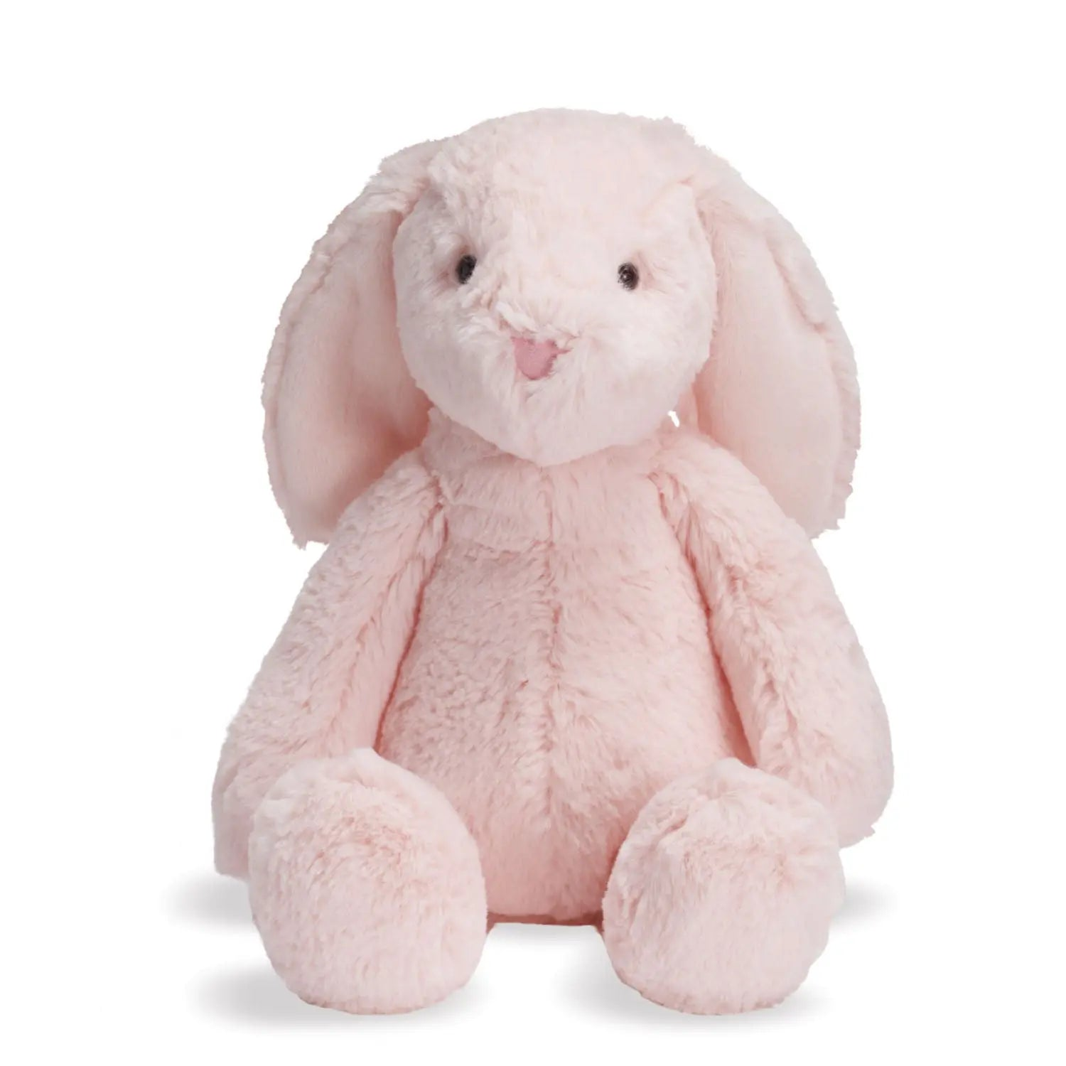
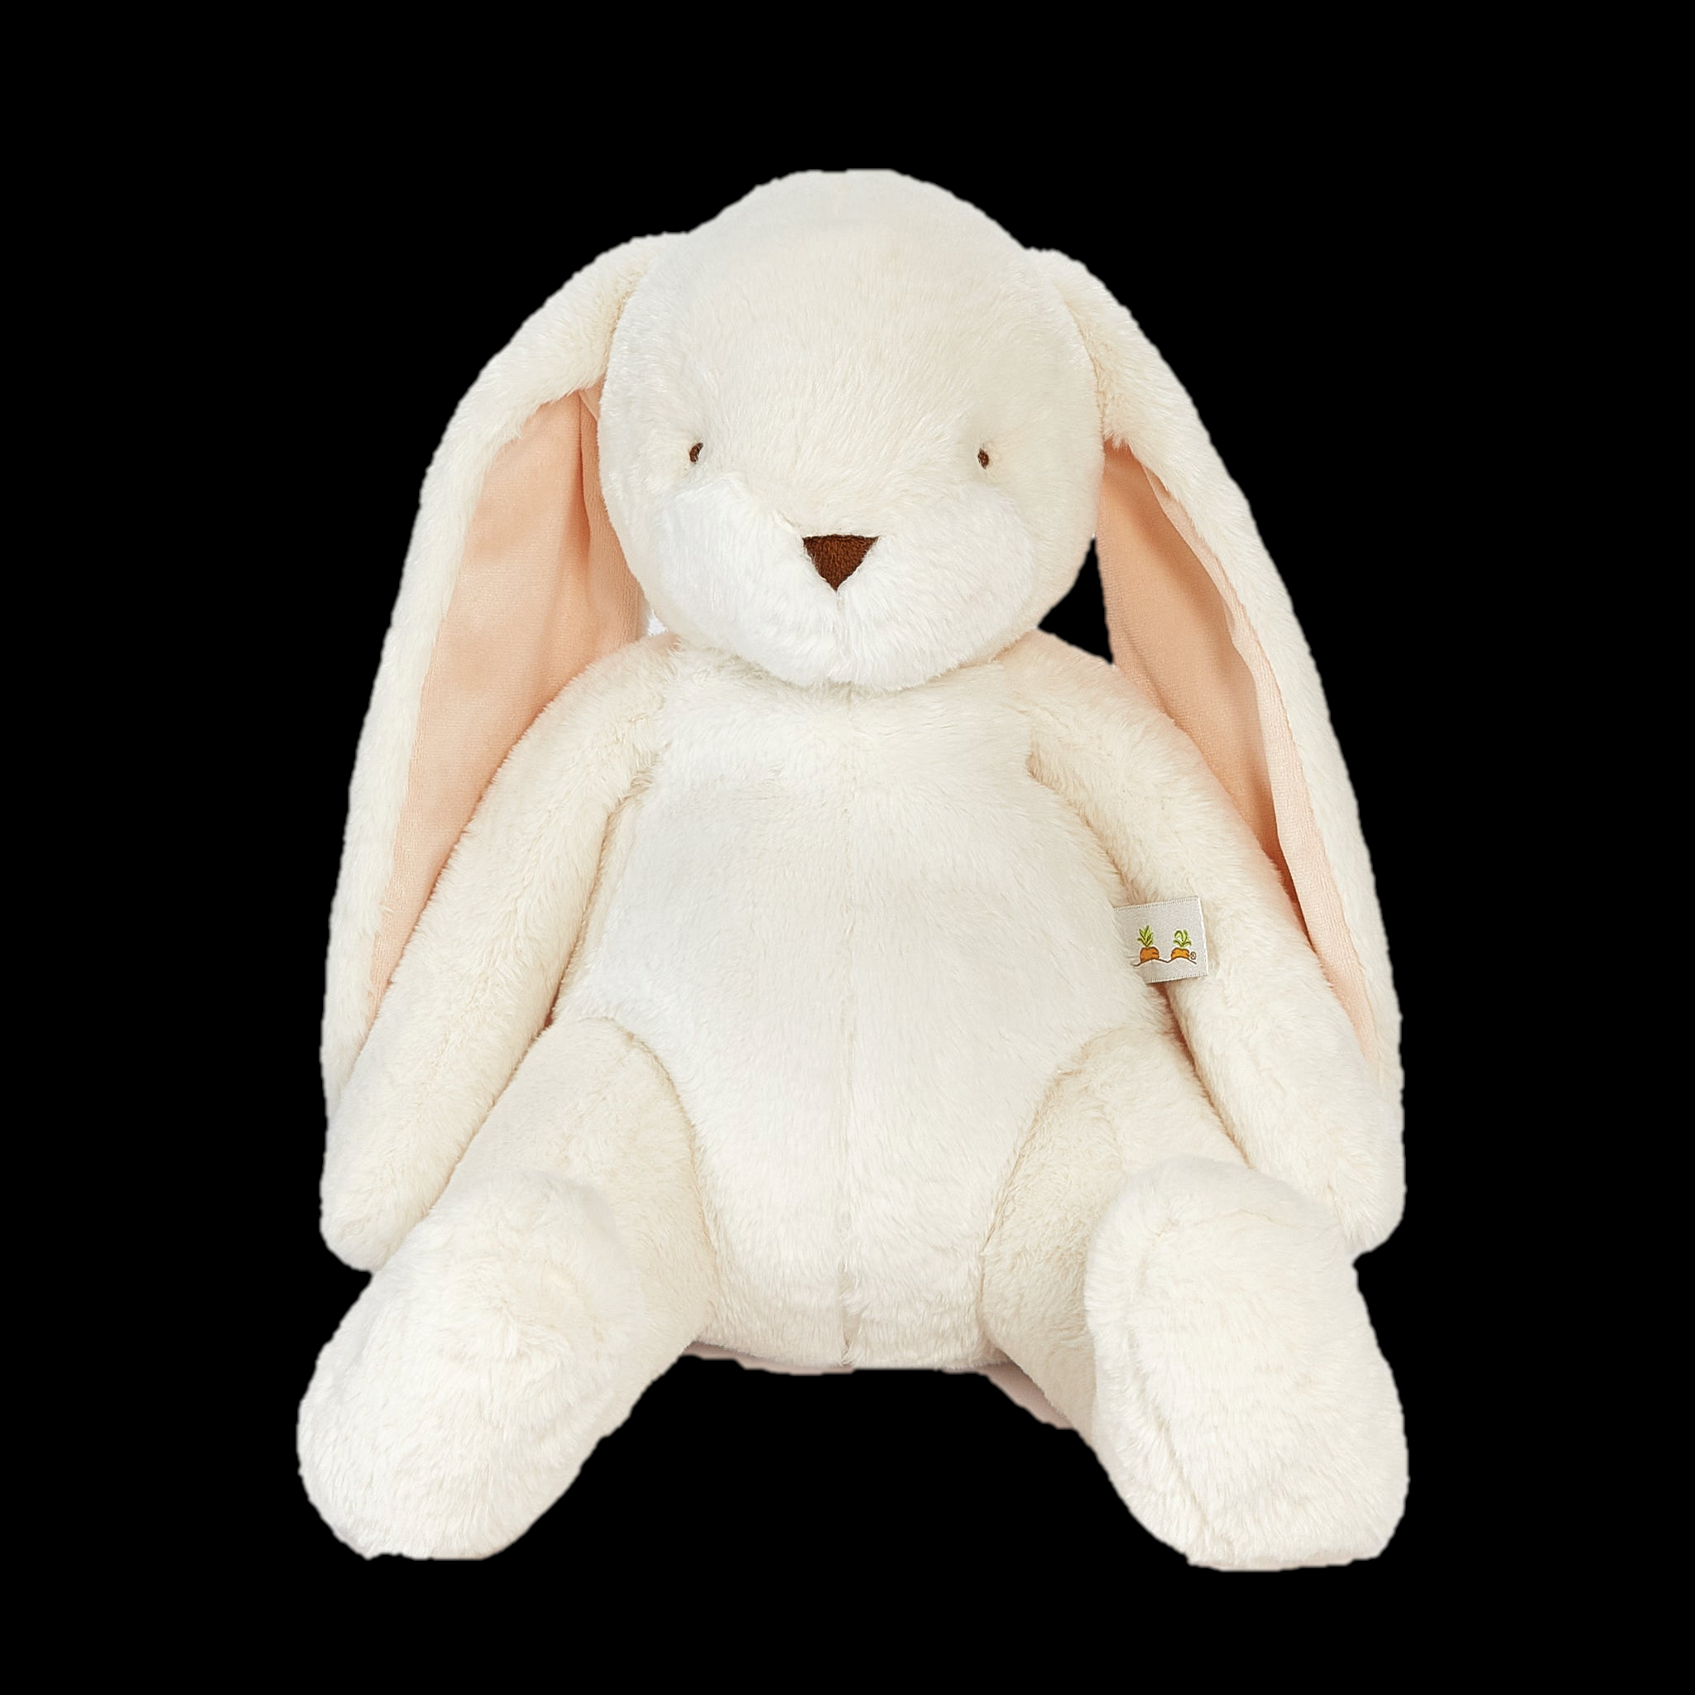
Attachment in early life
Objects that hold memories
BACK
As children, we must learn to interact with the vast world around. For this, we choose certain “anchors” as a safety mechanism.
These objects may include any object which is within grasp, and may help us develop anything from motor to social skills, as we breathe life into them.
As most things in life, these anchors may fade over time, from wear or loss.
Even if we know that these objects are replaceable and inanimate, it can be hard to find something that fits perfectly.
In a world of uncertainty, our memories provide us with both good and bad memories, sometimes both in the form of nostalgia (longing for the past) and melancholy (bitter-sweet feeling after an experience).

Slide 3
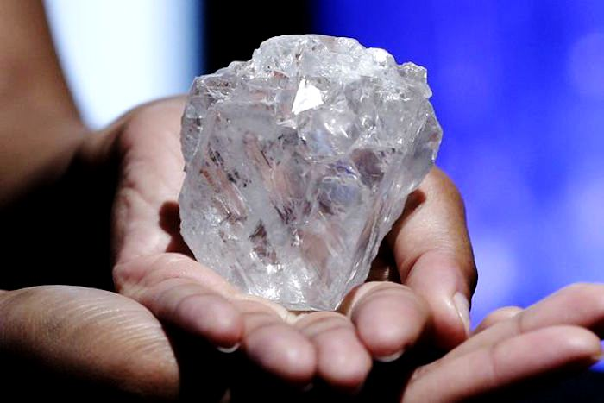
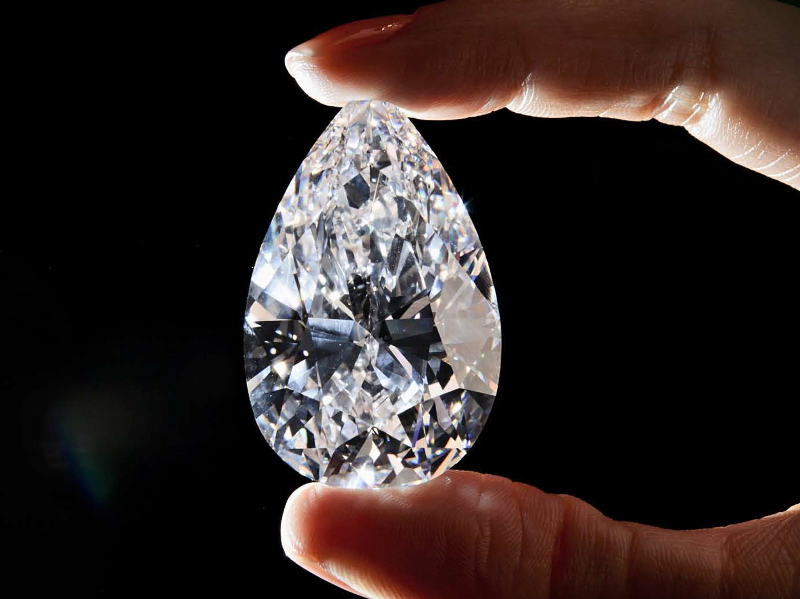
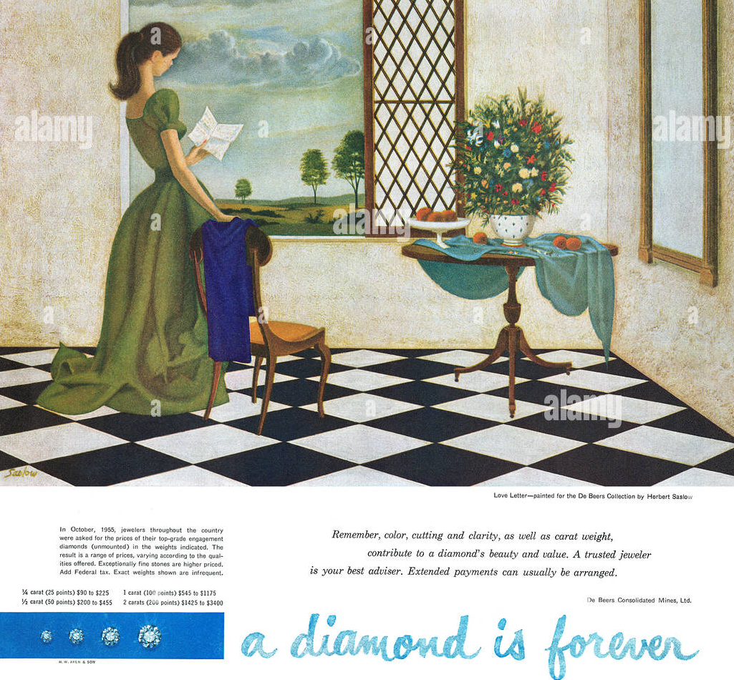
What it means to be “valuable”
Objects that hold memories
BACK
Value is the perceived importance of an object. One of the ways our ancestors survived was by trade, and trade requires an agreement on what is wanted and what can be given away by one.
Value, however is also the positive opinion many people may have of one object moreso than another, even if both are of the same rarity or material, basedy solely on our memories of that object.
Advertisements often embed themselves in our memories, so that their product seems more “valuable” when compared to others objectively.
Early De Beers advertisement of diamonds

Slide 4
And yet…
Objects that hold memories
BACK
Value may be completely detached from material cost. Something cheap may still hold very important significance for any person.
Our memories are the most powerful advertisement for perception, because they give us more than just material wealth.
They provide us with self-assurance and an outlet for various emotions when needed most.

Slide 5
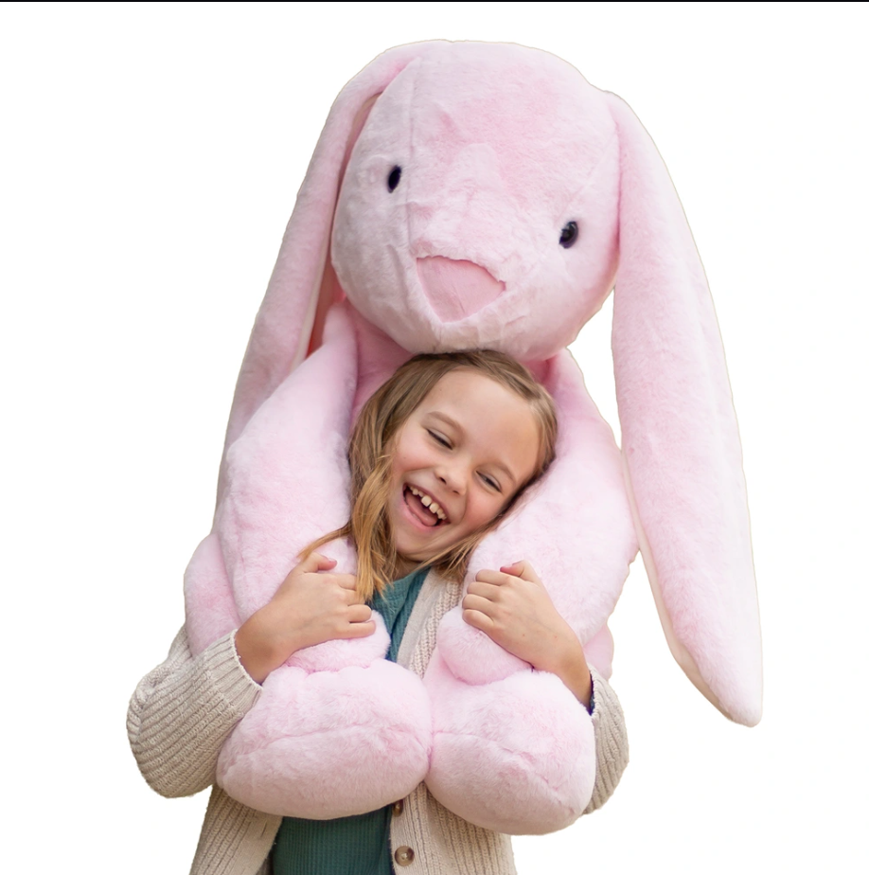
An object that holds memories…
Objects that hold memories
Is an invaluable object for our mental health, and should always be cherished no matter the age.
BACK
Notes:
END OF CHAPTER

Slide 6
How memories work
How memories work

Slide 7
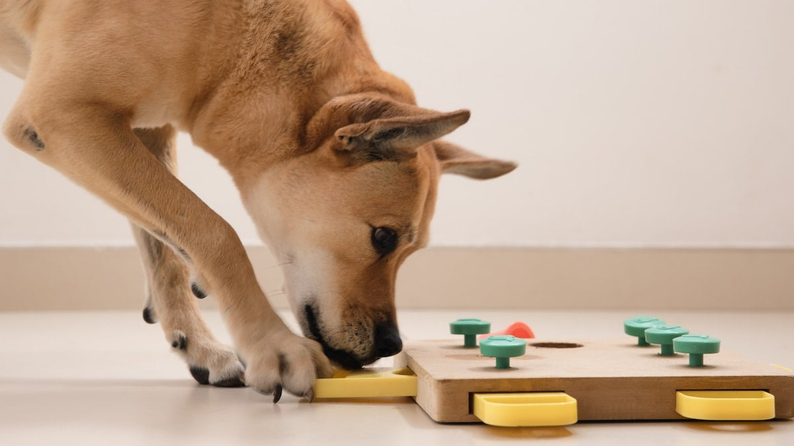
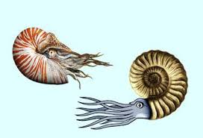
Why do we remember?
How memories work
BACK
Our ancestors, back even before humans began to populate the earth, needed to avoid varied dangers. Whether a food was deadly or delicious, another living being friend or foe, and so on.
Thus, memories achieve that exact purpose by storing what we need to know about a thing and how to proceed best based on our previous interaction.
Today’s world is all about remembering things, and all of us owe it to the ingenious creatures that evolved the ability to store such information, the earliest of which being the deep-sea nautilus over 500 million years ago.

Slide 8
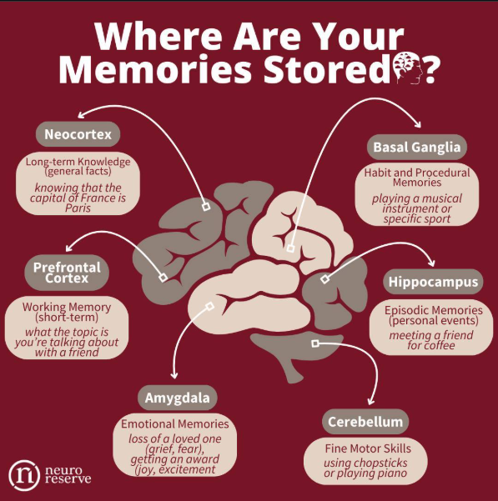
How do we store memories?
How memories work
BACK
Have you ever wondered how memories are stored? Well, it’s quite simple.
Memories are stored as synaptic connections of neurons either being weakened or strengthened. In layman’s terms, the brain modifies connections between neurons as required to give us a collection of information that, when needed, can “remake” that particular moment.
This happens everywhere inside the brain. Each section takes care of storing a specific type of information.
This is why we can sometimes only recall certain aspects of a memory, such as a sound, smell, taste, or image.

Slide 9
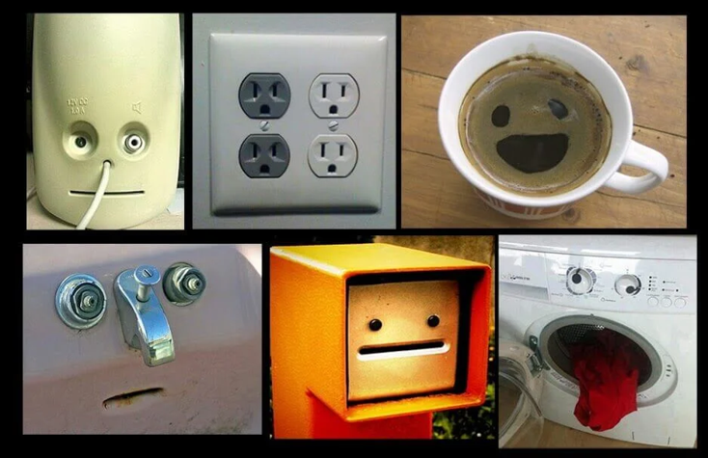
Pareidolia: How the brain can influence perception
How memories work
BACK
Pareidolia, the process of seeing faces in inanimate objects, is a good example of how our brains are wired to instinctually find threats in nature.
We spot these “faces” in objects even when, logically, we know they aren’t there.
They are simply images that confuse our brain and trigger primal memories, so that our brains have an angle when trying to evaluate if they are friend or foe.

Slide 10
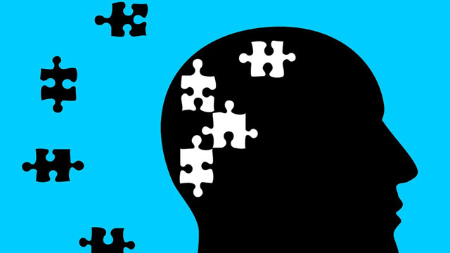
Forgetting: a misunderstood ally
How memories work
BACK
Do you remember all of your childhood doubts? What about all your failures as a preteen? And all the times you fell over as a toddler?
Forgetting is often seen as a misfortunate part of life. You forget where you left your keys, your homework, or sometimes even important meetings. But do not be mistaken, forgetting is as important as breathing.
Forgetting is the process of discarding old information in order to remember something new, but can also discard the bad things in our lives
Take a moment to appreciate all the hard work forgetting does to keep you happy and healthy, because chronic problems like PTSD (the perpetual recollection of a very stressful event) could happen with every bad memory if it weren’t for it.

Slide 11
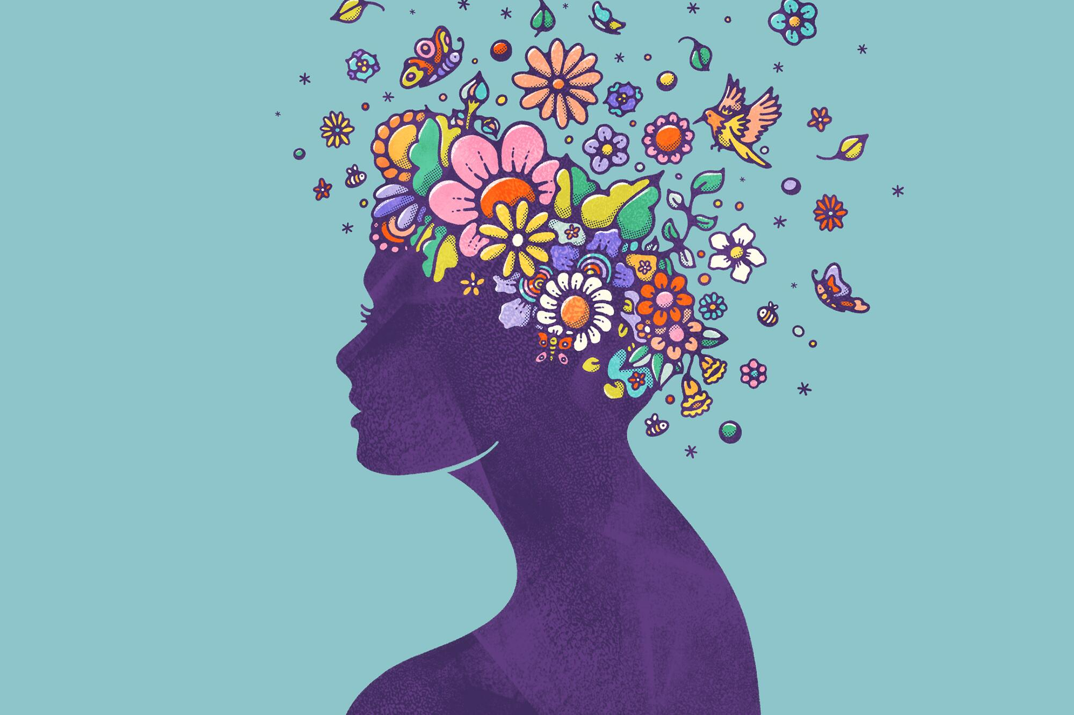
Conclusions
How memories work
Memories, stored as a collection of strong connections between neurons, are necessary for our development and evolution as a species.
Forgetting is also as essential to that evolution as remembering, because forgetting clears up the brain for the next set of memories.
BACK
Notes:
END OF CHAPTER

Slide 12
How memories shape us
How memories shape us

Slide 13
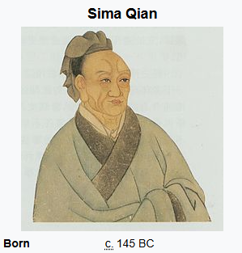
Nature vs Nurture
How memories shape us
BACK
Memories play a big role in our nurture. Growing up, the society around us forms us into who we are. Our nature plays a big role in who we are at our core, but only through experience do we become functioning members of society.
This debate is longstanding, and is yet to be resolved fully, since personhood is a complicated matter and we still don’t know how personalities are formed.
My personal opinion is that memories, in their essence, are both formed AND inherited, since both nature and nurture play the important role of forming us as people.
Sima Qian, chinese scribe who first tackled the nature vs nurture argument

Slide 14
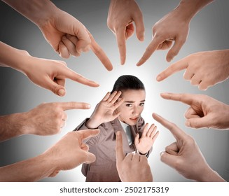

Dealing with stressful events
How memories shape us
BACK
Day to day living sometimes isn’t the most ideal, especially when something goes overtly wrong, worst of all when it’s because of something we did.
Memories, as tools for social interaction, are used mainly to avoid repeating bad situations. This means that we use memories to learn from our past mistakes and improve ourselves.
Thus, for most people, stressful memories serve as a deterrents for unacceptable behavior in society.
This is also where forgetting comes into play: once a certain situation’s consequences pass and the brain decides that everything will be alright, it clears up more room and gradually forgets the event, only keeping the lessons.

Slide 15

Who we used to be
How memories shape us
Whether we truly inherited our personality or not, we are all responsible and entirely made up of our actions.
Without our past mistakes, we wouldn’t be able to grow as people. Without the past, we would be lost and without guidance.
Trust your nature, improve your nurture, and always keep your mind sharp.
BACK

Slide 16
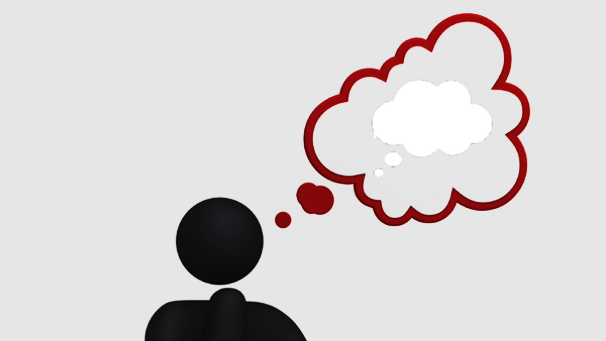

What are…
Coordinated by: Magda Botezat
A presentation by: Dacian Buzlea
Memories?

Slide 17
Memories?
Coordinated by: Magda Botezat
A presentation by: Dacian Buzlea

Slide 18
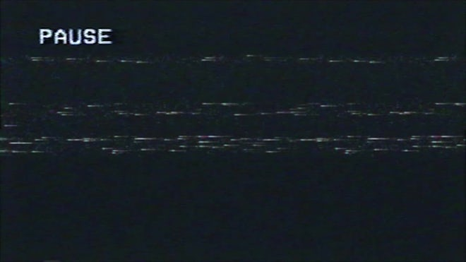
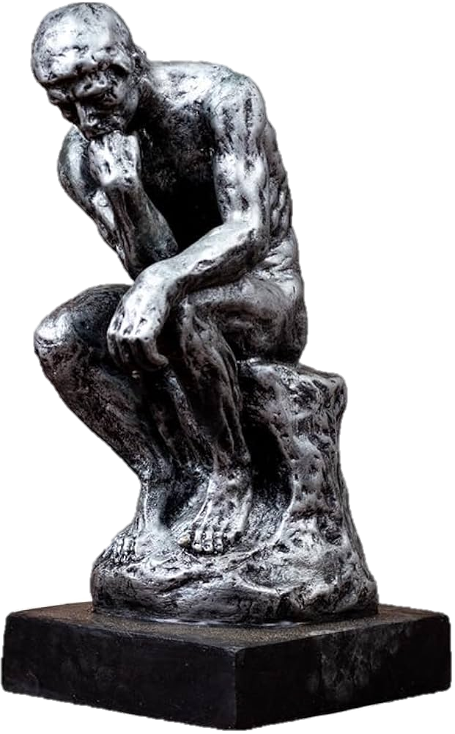
How memories work
Coordinated by: Magda Botezat
A presentation by: Dacian Buzlea
How memories shape us
Objects that hold memories

Slide 19
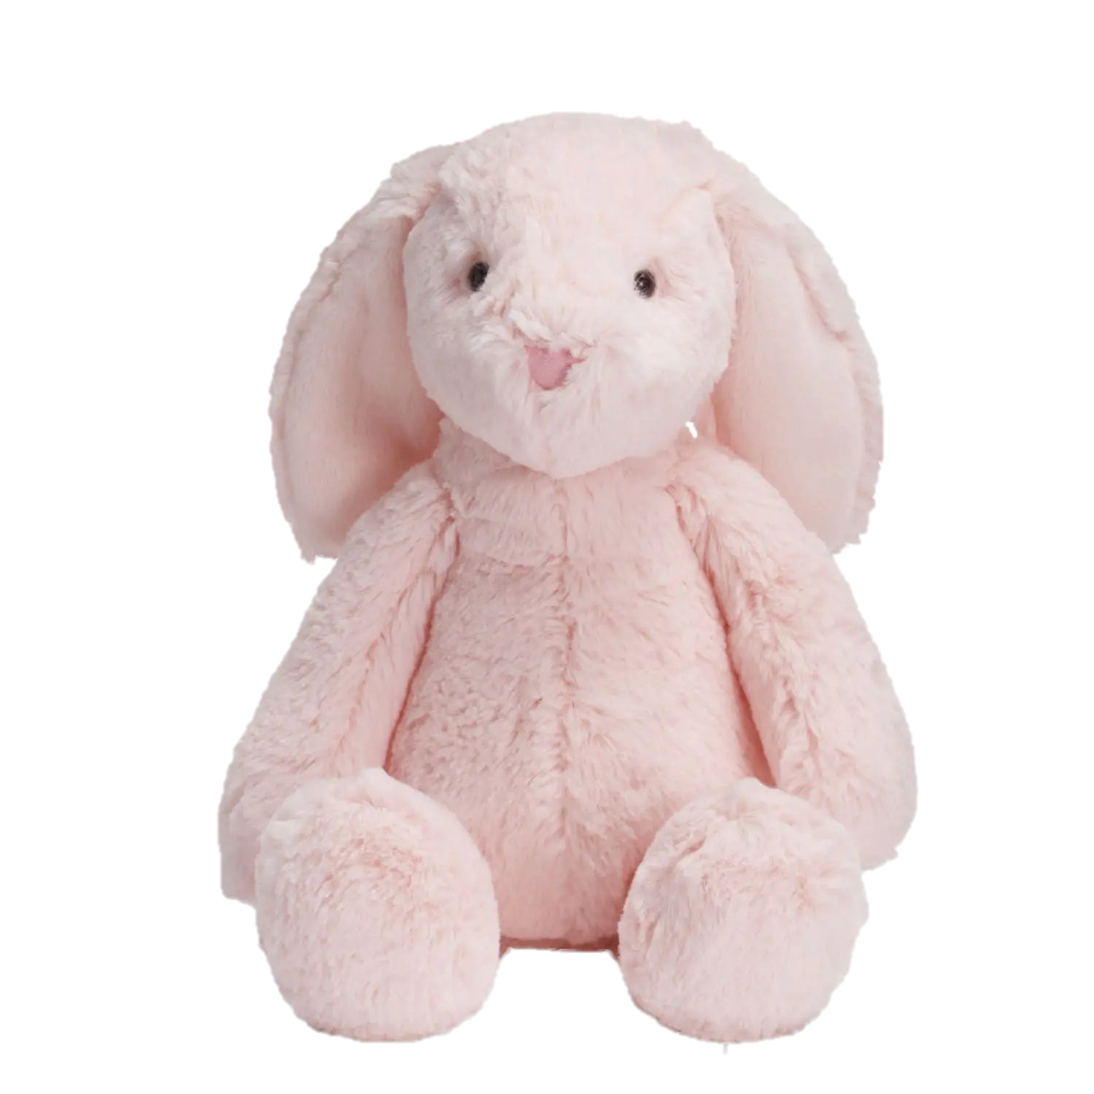
ONE MORE THING!
Remember to cherish your memories, always. You wouldn’t be the same person without them. :D

Slide 20
Bibliography + Webography
Plush bunny image
Pareidolia image
Teardrop diamond image
De Beers advertisement image
Cambridge definition of Value
VHS Pause screen overlay image
Study of where memories are stored
Person forgetting image
Dog solving puzzle image
Study on the nautilus
Difference between Nostalgia and Melancholy
Sima Qian, the originator of the nature v nurture debate
Societal pressure image
First mindful image
Second mindful image

Slide 21
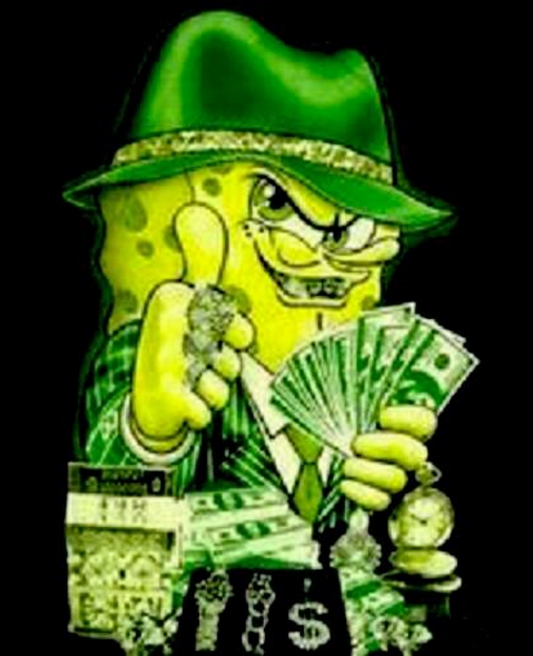
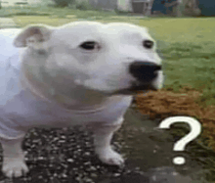
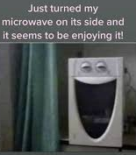
Thankyou for your mindfulness!

